Slide 1
A very brief introduction to
Matrix
(Section 2.7)
Definitions
Some properties
Basic matrix operations
Zero-One (Boolean) matrices

Slide 2
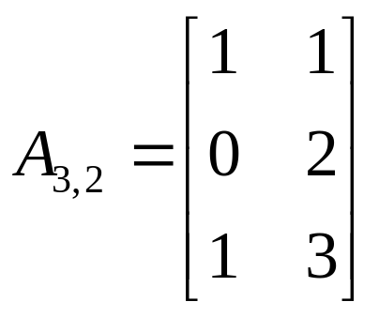
Matrix (Section 2.7)
Definition: A matrix is a rectangular array of numbers. A matrix of m rows and n columns is called an m×n matrix, denoted A_{m×n}. The element or entry at the i^{th} row and j^{th} column is denoted a_{i,j}.
The matrix can also be denoted A = [a_{i,j}].
Example
a_{2,3} = 2
row
column

Slide 3
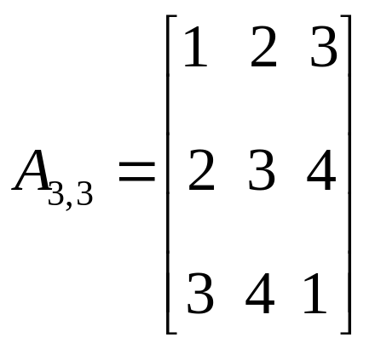
Matrix
Two matrices A_{m×n} and B_{p×q} are equal if they have the same number of rows and columns (m = p and n = q), and their corresponding entries are equal (a_{i,j} =b_{i,j} for all i, j).
A_{m×n} is a square matrix if m = n, denoted A_{m}
A square matrix A is said to be symmetric if a_{i,j} = a_{j,i} for all i and j.

Slide 4
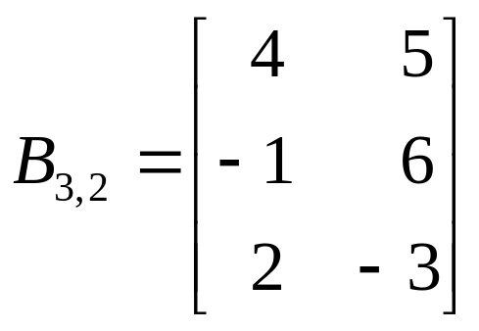
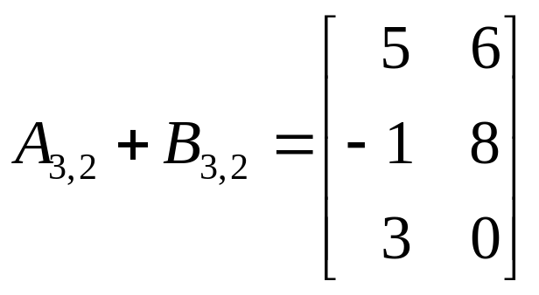
Matrix arithmetic (operations)
Matrix addition. A_{m×n} and B_{m×n}
must have the same numbers of rows and columns
add corresponding entries
A_{m×n} + B_{m×n} = C_{m×n} = [a_{i,j} + b_{i,j}]
Matrix subtraction is done similarly

Slide 5
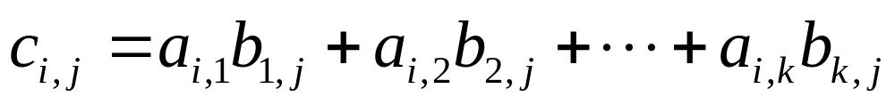
Matrix arithmetic (operations)
Multiply a matrix by a number.
b⋅A = [b⋅a_{i,j}] (i.e., multiply the number to each entry.)
Multiplication of two matrices. A_{m×k} and B_{k×n}
number of columns of the first must equal number of rows of the second
the product is a matrix, denoted AB = C_{m×n}
Entry c_{i,j} is the sum of pair-wise products of the i^{th} row of A and j^{th} column of B

Slide 6
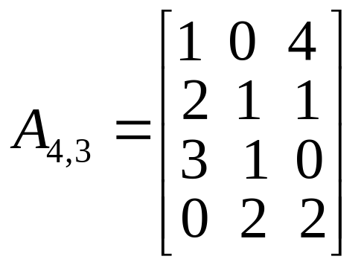
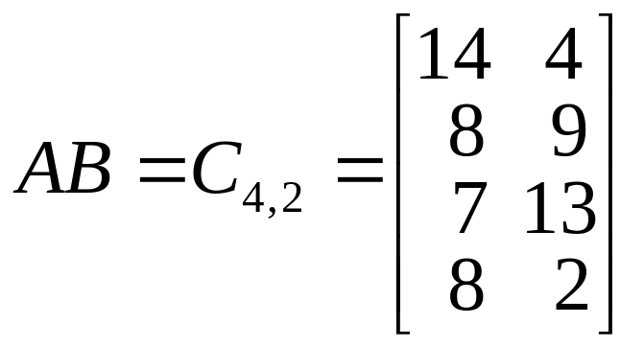
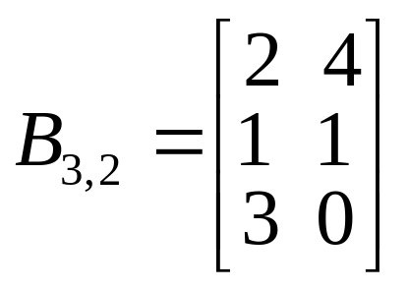
Matrix arithmetic (operations)
Example

Slide 7
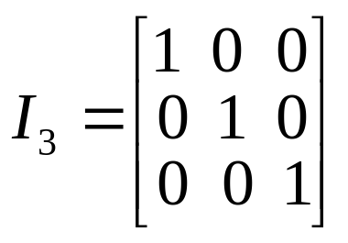
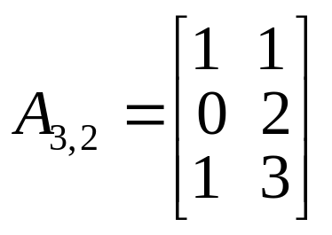
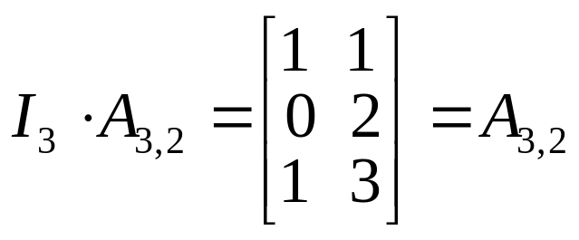
Powers and Transposes
Identity matrix: I_{n}
A square matrix of n rows and n columns
Diagonal entries are 1, all other entries are 0
(i_{i,i} = 1 for all i, i_{i,j} = 0 for all i != j.)
For matrix A_{m×n}, we have I_{m} A = A I_{n} = A
Powers of (square) matrix A_{n}
A⁰ = I_{n} =, A^{r} = AA···A
r times

Slide 8
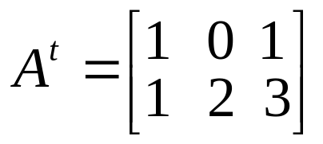
Powers and Transposes
Matrix transpose: A_{m×n}
the transpose of A, denoted A^{t}, is a n ×m matrix
A^{t} = [b_{i,j} = a_{j,i}]
i^{th} row of A becomes i^{th} column of A^{t}
Theorem: A square matrix A_{n} is symmetric iff
A = A^{t}

Slide 9
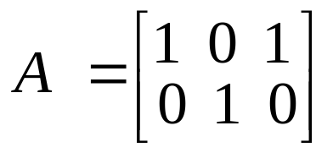
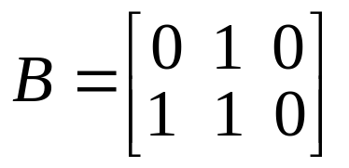
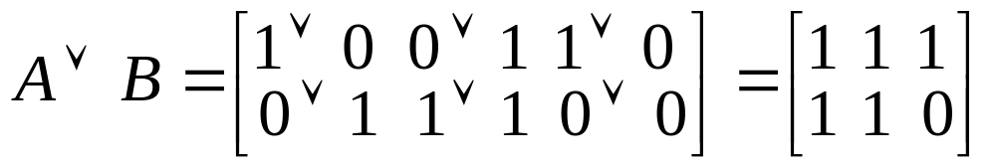
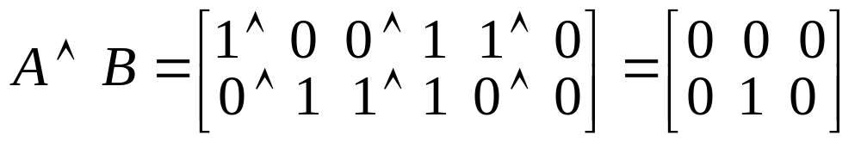
Zero-One (Boolean) Matrix
Definition:
Entries are Boolean values (0 and 1)
Operations are also Boolean
Matrix join.
A ∨ B = [a_{i,j} ∨ b_{i,j}]
Matrix meet.
A ∧ B = [a_{i,j} ∧ b_{i,j}]
Example:

Slide 10
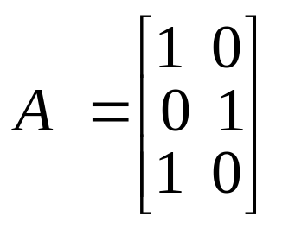
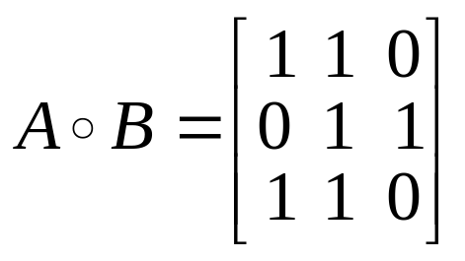
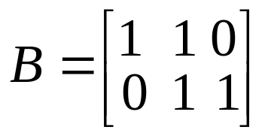
Zero-One (Boolean) Matrix
Matrix multiplication: A_{m×k} and B_{k×n}
the product is a Zero-One matrix, denoted AοB = C_{m×n}
c_{ij} = (a_{i1} ∧ b_{1j}) ∨ (a_{i2} ∧ b_{2i}) ∨ … ∨ (a_{ik} ∧ b_{kj}).
Example:

